Slide 1
Module 8
AI ML and Data Analytics

Slide 2
Outline
MODULE 8 INTRODUCTION
  Introduction to AI and Machine Learning
AI/ML ON AWS
  AI/ML on AWS
  AWS AI/ML Solutions
  Introduction to Generative AI on AWS
  AWS Generative AI Solutions
DATA ANALYTICS ON AWS
  Introduction to Data Analytics
  Data Pipelines on AWS
CLOUD IN REAL LIFE
  Data Analytics and AI/ML

Slide 3
Introduction to AI and Machine Learning

Slide 4
Key concepts
Let's review a couple of key definitions for artificial intelligence and machine learning. You will build on these concepts in the following lessons.
  AI
    Artificial Intelligence is a broad field focused on the development of intelligent computer systems capable of performing humanlike tasks.
  ML
    Machine learning is a type of AI for training machines to perform complex tasks without explicit instructions.
    Machine learning training finds the patterns hidden in vast amounts of historical data to produce an ML model.
    This ML model can then be applied to new data to make predictions or decisions based on the patterns it's learned.

Slide 5
AI/ML on AWS

Slide 6
In this lesson, you will learn:
Identify common business use cases for AI/ML.
Identify the three tiers of AI/ML solutions offered by the AWS AI/ML stack.

Slide 7
AWS AI/ML three tiers
AI/ML helps solve for many common business use cases.
At AWS, solutions for these common use cases, and others, are offered through the AWS AI/ML stack:
AWS AI Services (Pre-trained, Plug-and-Play)
  These are fully managed APIs with pre-built, pre-trained ML models that solve specific business problems without needing ML expertise.
  Examples:
    Amazon Polly → Converts text to speech (great for voice assistants or accessibility apps).
    Amazon Comprehend → Natural language processing (sentiment analysis, topic extraction).
    Amazon Rekognition → Image & video analysis (object detection, face recognition).
    Amazon Transcribe → Automatic speech-to-text.
    Amazon Translate → Real-time translation across multiple languages.

Slide 8
1. AWS AI Services (Pre-trained, Plug-and-Play)
Use cases:
  Customer support chatbots that understand and respond to natural language.
  Auto-generating subtitles for videos in multiple languages.
  Detecting inappropriate content in user-uploaded images.
  Voice-enabled applications (e.g., reading news aloud).
  Best when: You want fast results, no ML expertise, and don’t need to customize models deeply.

Slide 9
2. AWS ML Services (Build, Train, Deploy with SageMaker)
These services give you the flexibility to build your own models on a fully managed ML platform.
The flagship here is Amazon SageMaker.
What SageMaker offers:
  Data labeling & preprocessing.
  Model training at scale (distributed training jobs).
  Hyperparameter tuning.
  Model deployment with monitoring and debugging.
  Integration with Jupyter notebooks for experimentation.
Use cases:
  Building a fraud detection model for an online banking system.
  Training a personalized recommendation engine beyond what AWS AI services offer.
  Predicting demand for coffee beans in your coffee shop chain based on past sales.
  Custom voice recognition system tuned to your business vocabulary.
Best when: You need customization, own data, and want more control without managing servers or ML infrastructure.

Slide 10
3. AWS Frameworks & Infrastructure (Custom, Deep ML/AI Workloads)
This is the most flexible layer for businesses with expert ML teams. You build ML pipelines from scratch using popular frameworks (TensorFlow, PyTorch, MXNet) on specialized AWS infrastructure.
Infrastructure options:
  EC2 P3 / P4 Instances → GPU-based, optimized for ML training.
  AWS Inferentia & Trainium Chips → Purpose-built ML accelerators for inference and training at scale.
  Deep Learning AMIs & Containers → Pre-configured environments for TensorFlow, PyTorch, etc.
Use cases:
  Developing next-generation generative AI models (LLMs, image generators).
  Running massive-scale simulations for finance, healthcare, or climate.
  Training proprietary ML models with billions of parameters.
  Hosting your own specialized ML infrastructure with full control.
Best when: You need total flexibility, already have an experienced ML/data science team, and want to push the boundaries of ML innovation.

Slide 11

In brief
AWS AI/ML solutions
The AWS AI/ML stack is composed of the following three tiers of solutions:
  AI services - pre-built models that are already trained to perform specific functions
  ML services - a more customized approach with Amazon SageMaker AI where you build, train, and deploy your own ML models with fully managed infrastructure
  ML frameworks and infrastructure - a completely custom approach to building models using purpose-built chips that integrate with popular ML frameworks

Slide 12
AWS AI/ML Solutions

Slide 13
In this lesson, you will learn:
Describe the benefits and purpose of the services contained in each tier of the AWS AI/ML stack.

Slide 14
Tier 1: Pre-built AWS AI services
The AWS AI services tier is made up of pre-built models that are already trained to perform specific functions.
These ready-to-use, managed services can help you quickly solve for a variety of business use cases.
In the next section, you will learn about the following three groups of AWS AI services:
  Language services
  Computer vision and search services
  Conversational AI and personalization services

Slide 15
Language services
AWS AI language services are great for when you need to interpret text or speech and transform it into something meaningful.
Let's examine how these services solve for some common use cases.
  Amazon Comprehend
    Amazon Comprehend uses natural language processing to extract key insights from documents. It develops these insights by recognizing key phrases, language, sentiment, and other common elements in documents.
    Use cases: Content classification, customer sentiment analysis, and compliance monitoring
  Amazon Translate
    Amazon Translate is a text translation service. This service is ideal for global communication because it supports real-time and batch text translation across multiple languages.
    Use cases: Document translation and multi-language application integrations

Slide 16
Language services
Amazon Polly
  Amazon Polly converts text into lifelike speech. It supports multiple languages, different genders, and a variety of accents.
  Use cases: Virtual assistants, e-learning applications, and accessibility enhancements for visually impaired users
Amazon Transcribe
  Amazon Transcribe converts speech into text. It supports multiple languages and offers features such as speaker identification, custom vocabulary, and real-time transcription.
  Use Cases: Customer call transcription, automated subtitling, and metadata generation for media content.

Slide 17
Computer vision and search services
These services are ideal for answering questions and gathering insights from various types of content sources such as documents, images, videos, and more. Let's look at some examples:
  Amazon Kendra
    Amazon Kendra uses natural language processing to search for answers within large amounts of enterprise content.
    Because it understands the context of a query, it can return more precise and relevant answers than just a list of documents with matching keywords.
    Use cases: Intelligent search, chatbots, and application search integration

Slide 18
Computer vision and search services
Amazon Textract
  Amazon Textract detects and extracts typed and handwritten text found in documents, forms, and even tables within documents.
  Use cases: Financial, healthcare, and government form text extraction for quick processing
Amazon Rekognition
    Amazon Rekognition is a video analysis service. It can identify objects, people, text, scenes, and activities within images and videos stored in Amazon Simple Storage Service (Amazon S3).
    Use cases: Content moderation, identity verification, media analysis, and home automation experiences

Slide 19
Conversational AI and personalization services
With these services, users can interact with your apps through text and voice conversations.
You can also present your customers with product recommendations personalized just for them. Let's explore these services.
Amazon Lex
  With Amazon Lex, you can add voice and text conversational interfaces to your applications. This service uses both natural language understanding (NLU) and automatic speech recognition (ASR) to create lifelike conversations.
  Use cases: Virtual assistants, natural language search for FAQs, and automated application bots
Amazon Personalize
  With Amazon Personalize, you can use historical data to build intelligent applications with personalized recommendations for your customers.
  Use cases: Personalized streaming, product, and trending recommendations

Slide 20
Tier 2: ML services
The ML services tier provides a more customized approach for customers who want a bit more control over their ML solutions without having to manage infrastructure.
SageMaker AI is a key offering in this tier.
Amazon SageMaker AI
  With this fully managed service, you can build, train, and deploy your own ML models without worrying about infrastructure.
  The SageMaker AI integrated development environment (IDE) provides simplified access control and transparency over your ML projects.
  You can track model training experiments, visualize data, and debug and monitor your workflows all within one environment.
  SageMaker AI even offers access to hundreds of pre-trained models that you can deploy in a few quick steps.

Slide 21
Key benefits of SageMaker AI
Choice of ML tools
Increase innovation with different tool choices. Data scientists can use the IDE, and business analysts can use the no-code interface.
Fully managed infrastructure
Focus on ML model development while SageMaker AI provides you with high-performance, cost-effective infrastructure.
Repeatable ML workflows
Automate and standardize your MLOps practices and governance across your enterprise to support transparency and auditability.

Slide 22
Tier 3: ML frameworks and infrastructure
Some organizations have highly specialized needs that require complete control over the ML training process.
They can use in-house expertise, ML frameworks, and AWS infrastructure to develop their own ML solutions.
Core components
  ML frameworks
    An ML framework is a software library or tool that provides experienced ML practitioners with pre-built, optimized components for building machine learning models.
    AWS supports ML frameworks like PyTorch, Apache M-X Net, and TensorFlow.
  AWS ML infrastructure
    AWS ML infrastructure, such as ML-optimized Amazon Elastic Compute Cloud (Amazon EC2) instances, Amazon EMR, and Amazon Elastic Container Service (Amazon ECS), can support these custom solutions. These services provide high performance and flexibility for advanced ML workloads.

Slide 23
Introduction to Generative AI on AWS

Slide 24
In this lesson, you will learn:
Describe deep learning and its subset, generative AI.
Identify the types of generative AI solutions offered by AWS.

Slide 25
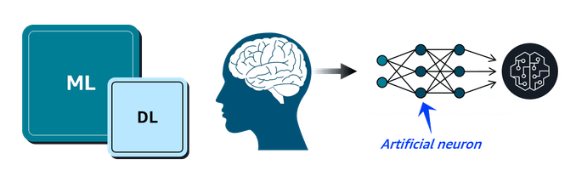
Deep learning
Deep learning (DL) is a subset of machine learning (ML) where models are trained using layers of artificial neurons that mimic the human brain.
Each layer of these neural networks summarizes and feeds information to the next layer until a final model is produced.

Slide 26
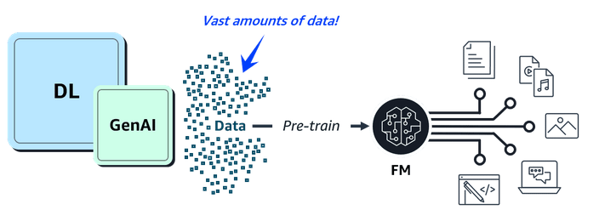
Generative AI
Generative AI is a type of deep learning (DL) powered by extremely large ML models known as foundation models (FMs).
FMs are pre-trained on vast collections of data. While traditional ML models are trained to perform singular tasks, FMs can be adapted to perform multiple tasks.
Large language models (LLMs), are a popular type of FM trained to use human language.
Foundation models can also be used to create videos, images, music, and more.

Slide 27
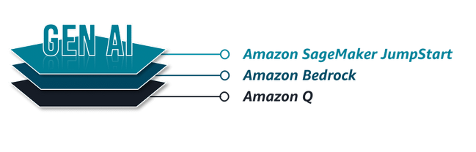
Generative AI on AWS
AWS offers the following types of generative AI solutions:
  Amazon SageMaker JumpStart—An ML hub with FMs and pre-built ML solutions deployable with a few clicks
  Amazon Bedrock—A fully managed service for adapting and deploying FMs from Amazon and other leading AI companies
  Amazon Q—An interactive AI assistant that can be integrated with a company's information repositories

Slide 28
AWS Generative AI Solutions

Slide 29
In this lesson, you will learn:
Describe the benefits and purpose of the generative AI services offered by AWS.

Slide 30
Amazon SageMaker JumpStart
SageMaker JumpStart is a machine learning hub within SageMaker AI that accelerates the process of building, training, and deploying ML models.
SageMaker JumpStart offers a library of pre-built ML solutions across various domains such as computer vision, NLP, and tabular data.
These pre-trained models can be fine-tuned to suit your specific needs and deployed with just a few clicks.

Slide 31
Common use cases for SageMaker JumpStart
Rapid ML model deployments
Quickly deploy pre-trained models without extensive ML expertise.
Custom fine-tuned solutions
Fine-tune pre-trained FMs with your domain-specific data.
ML experiments and prototypes
Compare performance for different models before committing to a specific approach.

Slide 32
Amazon Bedrock
Amazon Bedrock is a fully managed service that was specifically designed for working with large foundation models and building generative AI applications.
It provides access to FMs from Amazon and leading AI startups, such as Claude and Stable Diffusion, all through a single unified API.
With Amazon Bedrock, you can quickly experiment with FMs, fine-tune them with your own data, and seamlessly integrate them into your AWS applications.

Slide 33
Common use cases for Amazon Bedrock
Enterprise-grade generative AI
Build production-ready generative AI applications with enterprise-level security, privacy, and scalability.
Multimodal content generation
Create applications that can generate multiple content types, such as text and images.
Advanced conversational AI
Develop advanced conversational agents that connect to your enterprise data to provide accurate responses.

Slide 34
Amazon Q products
Amazon Q is a generative AI assistant that can help companies streamline processes, get to decisions faster, and improve employee productivity.
It can help every employee gain insights into their data and accelerate their tasks.
Amazon Q consists of the following two products:
  Amazon Q Business
    Amazon Q Business can answer pressing questions, help solve problems, and take actions using the data and expertise found in your company's information repositories.
    Amazon Q Business provides this tailored assistance with a secure connection to commonly used systems.
    Use cases: Information requests, automated workflows, and insight extraction
  Amazon Q Developer
    Amazon Q Developer provides code recommendations to accelerate development for coding languages including C#, Java, JavaScript, Python, and TypeScript applications. It integrates with multiple IDEs and helps developers write code faster by generating entire functions and logical blocks of code.
    Use cases: Faster code generation, improved reliability and security, and automated code reviews

Slide 35
Introduction to Data Analytics

Slide 36
In this lesson, you will learn:
Describe the benefits and purpose of ETL data pipelines.
Define data analytics.

Slide 37
Data pipelines for ETL processes
Both AI/ML and traditional data analytics need clean and accessible data in a format that's usable by analytics tools and AI algorithms.
ETL processes are used for this purpose. With ETL, you perform the following steps:
  Extract the data from various sources and store it.
  Transform it into a consistent, usable format for downstream tools to consume.
  Load it into a destination system, like a data warehouse or analytics platform.
Data pipelines are automated assembly lines used to make the ETL process efficient and repeatable.
AWS has a suite of integrated services so you can build your own data pipelines.

Slide 38
Data analytics
Data analytics is when analysts transform raw historical data to uncover valuable insights and trends.
This traditional data analysis can apply to important use cases, such as the following:
  Loan companies explaining lending decisions to customers.
  Medical researchers analyzing clinical trial data through hypothesis testing.
  Insurance companies making their risk assessment models transparent for regulators.

Slide 39
Data Pipelines on AWS

Slide 40
In this lesson, you will learn:
Describe the AWS services used in each phase of a typical AWS data pipeline.

Slide 41
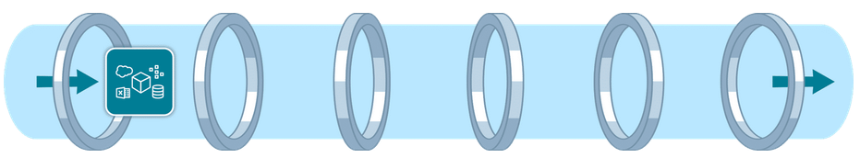
AWS data pipeline services
Data ingestion services
  Data ingestion involves moving data from source systems into your chosen storage solution.
  Use real-time ingestion when the data is needed immediately. Use batch ingestion when some latency is tolerable.

Slide 42
Data ingestion services
Amazon Kinesis Data Streams
  You can use Kinesis Data Streams for real-time ingestion of terabytes of data from applications, streams, and sensors.
  This serverless service even provides automatic provisioning and scaling in on-demand mode.
Amazon Data Firehose
  Firehose is an option for data ingestion in near real-time.
  This fully managed service provides automatic provisioning and scaling.
  It also delivers data within seconds to data lakes, warehouses, and analytics services.

Slide 43

Data storage services
Data can come from many different sources.
To gain insights, data is commonly consolidated into a single location.
There are two storage options for this:
  Flexible data lakes store vast amounts of raw data.
  Alternatively, the more structured data warehouses are optimized for business intelligence.

Slide 44
Data storage services
Amazon S3
  Amazon S3 is a popular choice for data lakes.
  This object storage service can securely house virtually any amount of structured or unstructured data.
  Amazon S3 is also fully elastic, automatically scaling as you add and remove data.
Amazon Redshift
  Amazon Redshift is a fully managed data warehouse service that can store petabytes of structured or semistructured data.
  With the scalability and pay-as-you-go pricing model, organizations can cost-effectively analyze large datasets.

Slide 45

Data cataloging services
Cataloging your data with metadata provides an inventory of your organization's data.
AWS Glue Data Catalog
  AWS Glue Data Catalog provides a centralized, scalable, and managed metadata repository that enhances data discovery.
  It improves the overall efficiency of data pipelines by delivering metadata to various data stores and analytics services.

Slide 46

Data processing services
Data processing services clean and transform your data so it's ready to be analyzed.

Slide 47
Data processing services
AWS Glue
  AWS Glue is a fully managed ETL service that makes data preparation simpler, faster, and cost effective.
  AWS Glue ETL jobs can use the AWS Glue Data Catalog to access metadata about data sources, which can help inform transformations defined in the ETL script.
Amazon EMR
  Amazon EMR is ideal for large-scale data processing and organizations with existing big data expertise.
  It automatically handles infrastructure provisioning, cluster management, and scaling.
  Amazon EMR supports popular big data frameworks like Apache Spark, Apache Hadoop, and Apache Hive.

Slide 48

Data analysis and visualization services
Queries and visualization tools help you to develop important insights about your data.

Slide 49
Data analysis and visualization services
Amazon Athena
  With Athena, you can run SQL queries to analyze data in relational, nonrelational, object, and custom data sources.
  This fully managed serverless service can access data hosted on Amazon S3, on premises, or even in multi-cloud environments.
  It offers a cost-effective solution for data analysis because you only pay for the queries you run.
Amazon Redshift
  Amazon Redshift is a fully managed data warehouse solution.
  Its columnar storage and massively parallel processing architecture make it ideal for analyzing large datasets.
  You can use it to perform complex SQL queries on large datasets for frequent, high-performance analytical workloads.

Slide 50
Data analysis and visualization services
Amazon QuickSight
  With QuickSight, both technical and non-technical users can quickly create modern interactive dashboards and reports from various data sources without managing infrastructure.
  Amazon Q in QuickSight provides natural language queries so business analysts and users can build, discover, and share meaningful insights in seconds.
Amazon OpenSearch Service
  With OpenSearch Service, you can search for relevant content through precise keyword matching or natural language queries.
  Unified dashboards provide real-time data visualization as you analyze and monitor logs, traces, and metrics for various applications.

Slide 51
Data Analytics and AI/ML

Slide 52
In this lesson, you will learn:
Explain how a real-life company might use an automated data pipeline for efficient data ingestion, processing, and delivery.

Slide 53
Data analytics and AI/ML architecture diagram
Delivering customer data for analysis and ML model training
  Let's discussin an e-commerce company uses an automated data pipeline to ingest, process, and deliver data to multiple stakeholders.
  As a result, data scientists and ML engineers can use the same data set for analysis and ML model training.

Slide 54
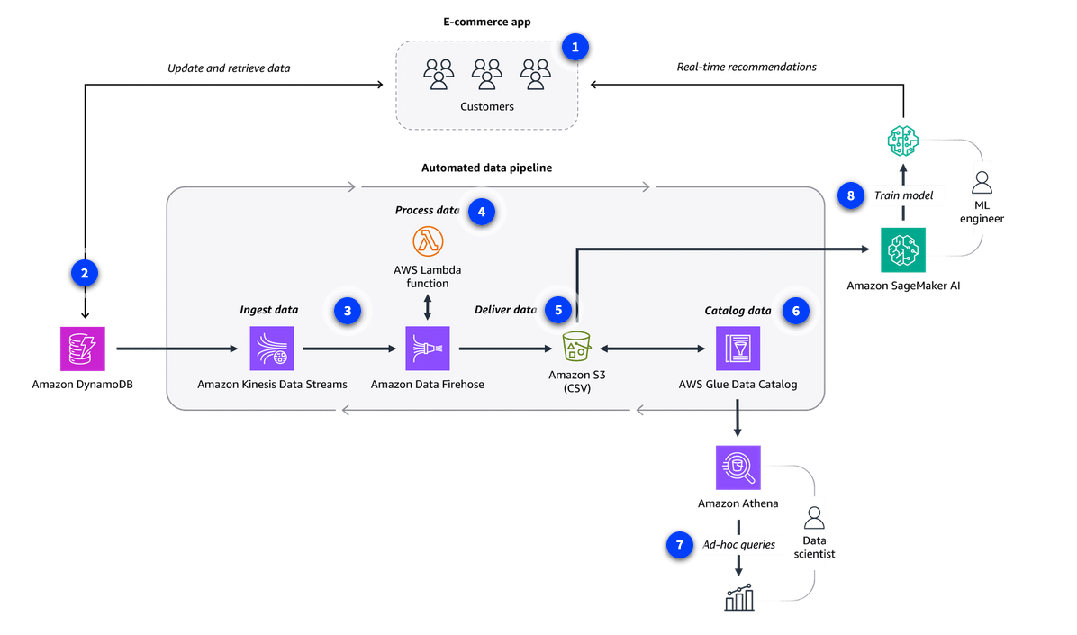
Data analytics and AI/ML architecture diagram
1. Make recommendations
An e-commerce company uses an ML model to make product recommendations.
2. Store app data
An Amazon DynamoDB database stores the historical customer data gathered through the app. This makes sense for low-latency reads and writes but isn't ideal for ML model training.
3. Ingest data
Kinesis Data Streams ingests the data from DynamoDB. Amazon Data Firehose then aggregates the data.

Slide 55
Data analytics and AI/ML architecture diagram
4. Process data
The data is in JSON format, so Firehose invokes an AWS Lambda function that transforms the data into .csv format.
5. Deliver data
Firehose then delivers the data to the company's Amazon S3 data lake, where it is available for multiple consumers.
6. Catalog data
AWS Glue Data Catalog serves as a metadata repository with tables that describe the schema and location of the Amazon S3 data.

Slide 56
Data analytics and AI/ML architecture diagram
7. Perform data analytics
Data scientists use Athena to gather insights through queries.
8. Train model
SageMaker AI reads the same dataset directly from Amazon S3. ML engineers can then train new versions of the recommendation model using the latest information.

Slide 57
Recap
AI/ML and data analytics are two fields that use high-quality data to analyze past events and innovate for the future.
In the previous lessons, you learned how AWS AI/ML solutions help to predict future trends and automate processes.
And you learned how AWS solutions can be used to analyze historical trends and develop insights from data.

Slide 58
Resources
Resource link | Description
Amazon Comprehend | Use natural language processing to extract key insights from documents.
Amazon Polly | Convert text into lifelike speech.
Amazon Transcribe | Convert speech into text.
Amazon Translate | Translate text into multiple languages.
Amazon Kendra | Use natural language processing to intelligently query enterprise content.
Amazon Rekognition | Identify objects and activities in images and videos.
Amazon Textract | Detect and extract typed and handwritten text in documents.
Amazon Lex | Add voice and text conversational interfaces to applications.
Amazon Personalize | Add personalized customer recommendations to applications.
Amazon SageMaker AI | Build, train, and deploy your own ML models without worrying about infrastructure.
Amazon SageMaker JumpStart | Deploy pre-trained ML solutions, like computer vision, NLP, and tabular data, with just a few clicks.
Amazon Bedrock | Fine-tune and seamlessly integrate large FMs from Amazon and leading AI startups into your AWS applications with a single API.
Amazon Q Business | Answer questions and solve problems using the data and expertise found in your company's information repositories.
Amazon Q Developer | Accelerate development with code recommendations.
Amazon Kinesis Data Streams | Ingest terabytes of streaming data in real time.
Amazon Data Firehose | Ingest and deliver data within seconds to multiple consumers, such as data lakes and warehouses.
Amazon S3 | Store virtually limitless amounts of all types of data using this popular data lake choice.
Amazon Redshift | Store petabytes of structured or semistructured data in this data warehouse service. Analyze large datasets stored in the warehouse using complex SQL queries.
AWS Glue Data Catalog | Provide metadata to various analytics services with this centralized repository.
AWS Glue | Process data by using the AWS Glue Data Catalog as a reference.
Amazon EMR | Process big data workloads by using popular frameworks like Apache Spark.
Amazon Athena | Analyze various data sources hosted anywhere with a single SQL query.
Amazon QuickSight | Visualize data by creating interactive dashboards with or without expertise.
Amazon OpenSearch Service | Visualize and monitor real-time data analytics with keyword or NLP searches.

